Slide 1
May 2024
PROFESSOR
STUDENT
University of Texas at Arlington
Dr. Angela Liegey-Dougall
Zehra Erden
Psych Students' Data Dive

Slide 2
Page
Table of
Contents
I
Dataset Introduction
3
II
Data Understanding
4
III
Data Preproccessing
7
IV
Word Frequency Analysis
8
V
Sentiment Analysis
10
VII
Machine Learning Approach
14
VI
Topic Modeling
18
VII
Topic-based Sentiment Analysis
24

Slide 3



Dataset Introduction
Survey Question
“When you think of data science, what does it mean to you
(please be honest and write what first comes to mind)?”
was asked to psychology students.
Text answers are saved in csv format.
> 255 rows (students)
> 7 features
Sentiment scores manually coded in the following format:
> ‘Sentiment (Manual)’: Very Positive, Positive, Neutral, Negative,
Very Negative
> ‘Manual Sentiment Score’: Scale of 1 to 5
> ‘Both Sentiment Exist’: Binary score to represent text contains
both sentiments.
3

Slide 4
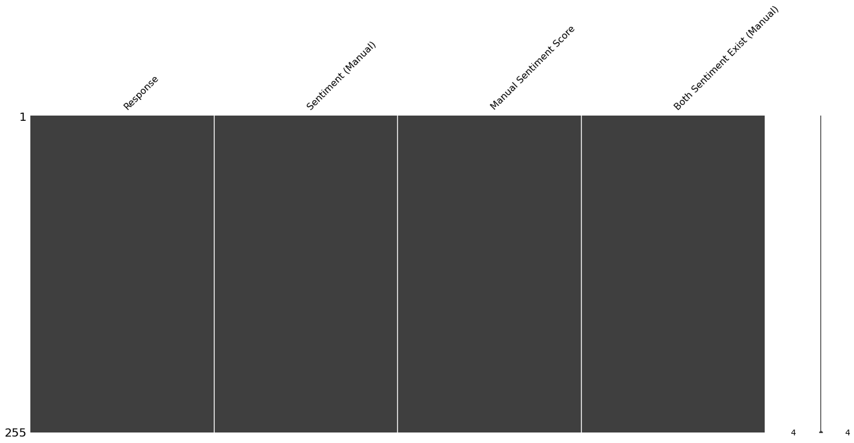
Data Understanding
Missing Values
Dataset does not have any missing (null) value.
4

Slide 5
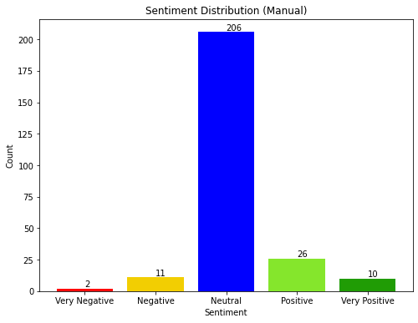
Data Understanding
Manually Coded Sentiment Distribution
Manual sentiment codes display that the majority of the responses are natural, while there are more positive responses than negative ones.
5

Slide 6
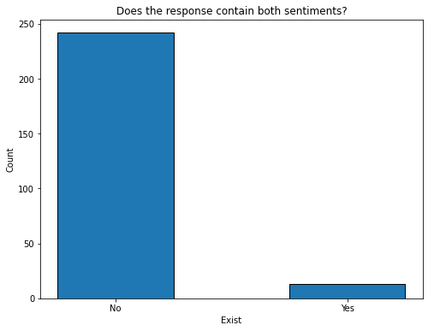
Data Understanding
Manually Coded Sentiment Distribution
Mean Sentiment Score (Manual): 3.12
Most Frequent Sentiment Category (Manual): Neutral
6

Slide 7
Data Preprocessing
Text Preprocessing
Techniques used:
> Converting the input text to lowercase
> Creating a set of English stop words
> Tokenization
> Removing non-alphanumeric characters from each token
> Lemmatization
> Additionally included stop words based on frequency on text:
'include', 'involve', 'data', 'science', 'think',
'know', 'may', 'way', 'like', 'something', 'using', 'lot', 'really'
7

Slide 8
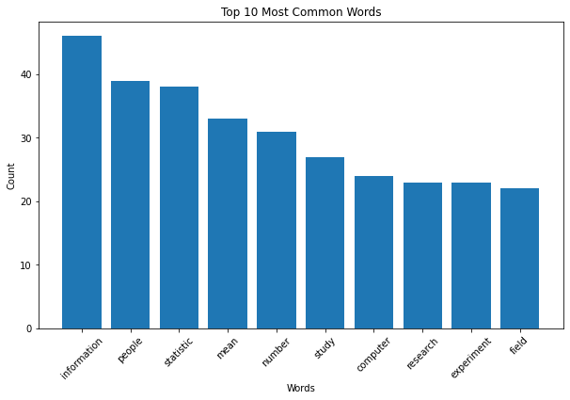
Word Frequency Analysis
10 Most Frequent Words
8

Slide 9
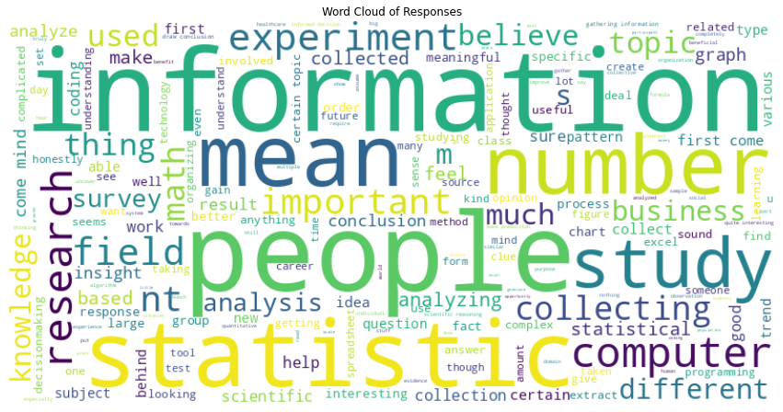
Word Frequency Analysis
Word Cloud of Responses
9

Slide 10

Sentiment Analysis
What is VADER?
> VADER (Valence Aware Dictionary and sEntiment Reasoner)
> A lexicon and rule-based sentiment analysis tool
> Assigns a sentiment score to a piece of text based on the words it contains, taking into account both the polarity (positive, negative, or neutral) and the intensity of the sentiment
10

Slide 11

Sentiment Analysis
Advantages and Disadtavgesof VADER
Open Source
Fast Processing
Domain Adaptability
Handles Negations and Intensifiers
Binary Classification
Dependency on Lexicon
Limited Context Understanding
Difficulty with Sarcasm and Irony
11

Slide 12
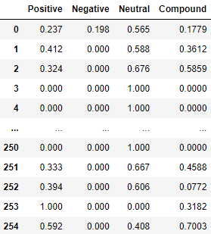
Sentiment Analysis
Tasks Done
Using the VADER SentimentIntensityAnalyzer, sentiment scores are calculated and assigned to each response/text.
We calculated the mean sentiment scores for each sentiment category.
12

Slide 13
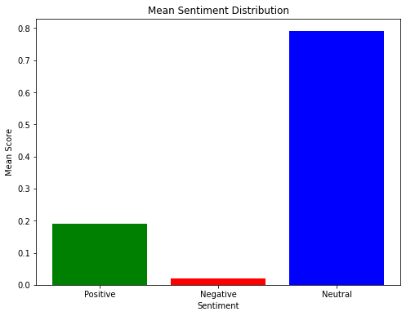
Sentiment Analysis
Overall Mean Sentiment Distribution of Responses
Lexicon-based sentiment analysis using VADER yielded similar results to our overall manually coded sentiments.
Most of the responses are neutral, with positive responses outnumbering negative ones.
13

Slide 14
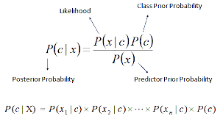
Machine Learning Approach
Why Naive Bayes Classifier?
> Naive Bayes classifiers perform well with text data, which is often sparse and high-dimensional.
> It performs reasonably well even with small training datasets.
> The probabilistic nature of Naive Bayes classifiers allows for easy interpretation of results.
14

Slide 15
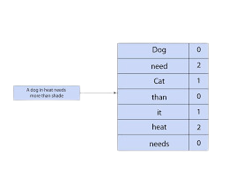
Machine Learning Approach
Vectorization
> Vectorization transforms textual data into numerical vectors that algorithms can process.
Bag of Words (BoW)
>BoW represents text data by counting the frequency of each word in a document. Each document is then represented as a vector, where each element corresponds to the count of a particular word in the document.
15

Slide 16
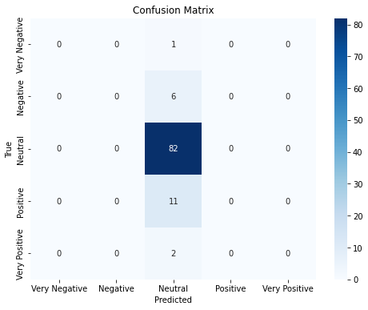
Machine Learning Approach
Model Evaluation
> The model is trained on manually coded sentiment scores and text data.
> Accuracy: 0.80
16

Slide 17
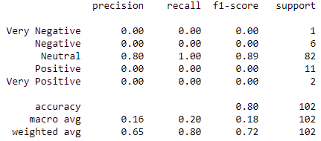
Machine Learning Approach
Model Evaluation
> Apparently the model did not perform well despite the good accuracy score.
> All metric scores are very high for ‘Neutral’.
> Looking at the confusion matrix too, if the model predicted all values only ‘Neutral’ it would get 80% accuracy.
17

Slide 18
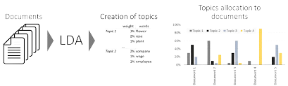
Topic Modeling
Latent Dirichlet Allocation (LDA)
> Latent Dirichlet Allocation (LDA) is a probabilistic topic modeling technique used for discovering latent topics within a collection of documents.
18

Slide 19
Topic Modeling
Why Latent Dirichlet Allocation (LDA) ?
> Assumes that each document in a corpus is a mixture of various topics
> It does not require labeled data for training
> Reduces the dimensionality of the text data by representing documents as distributions over topics and words
19

Slide 20
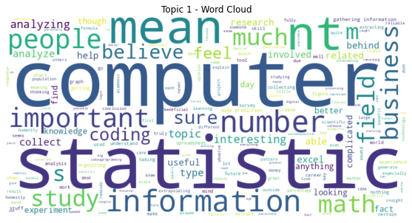
Topic Modeling
Topic 1 - Computer Science and Math
> Psychology students seem to see data science as a field combining computer programming, math and statistics.
20

Slide 21
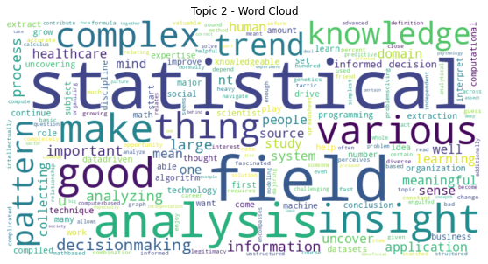
Topic Modeling
Topic 2 - Data Science as a Tool
> Psychology students do think that data science is a good tool to make various analysis to find trend, pattern, and meaning insight.
21

Slide 22
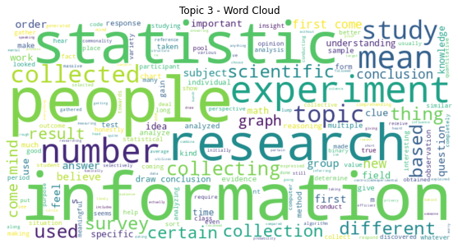
Topic Modeling
Topic 3 - Data Science in Psychological Research
> Psychology students match data science with researches and experiments in their field.
22

Slide 23
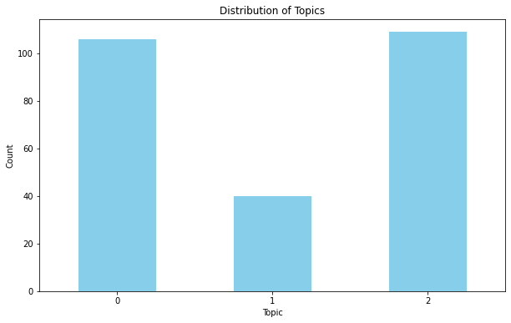
Topic Modeling
Distribution of Topics
Computer science, mathematics, and psychological research have been mentioned most frequently. Students appear to grasp the concept of data science and its impact on their respective fields, but they often perceive it merely as a tool.
1
2
3
23

Slide 24
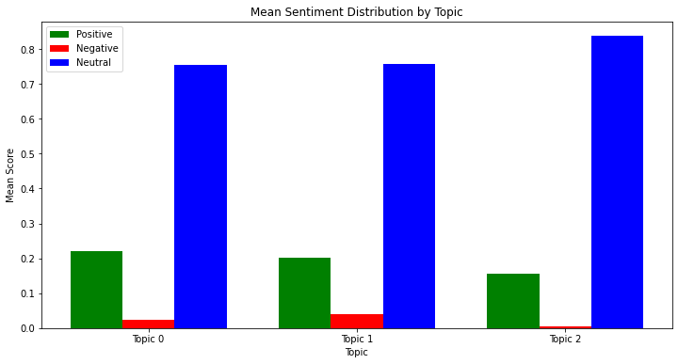
Topic-based Sentiment Analysis
Sentiment Distribution by Topic
1
2
3
24

Slide 25
Topic-based Sentiment Analysis
Conclusion
Overall students have positive approach through data science but are more negative against using data science as a tool.
This suggests a potential area of concern or misconception among students regarding the role and significance of data science as a practical tool within their academic disciplines.
25

